Slide 1
Life with The Pin
CCIM Institute provides its members with the most sophisticated knowledge, technology, and operational platform to power their business.

Slide 2
Notes:
Our membership is made up of commercial real estate specialists and allied professionals from across the globe. Each member has a different story to tell. But one thing unites us all. [click to next]

Slide 3
Notes:
The CCIM pin. The pin represents a 50-year legacy of investment analysis and fiduciary-level professionalism in all phases of the commercial real estate transaction. Our members are part of that legacy.

Slide 4
Why CCIM?
CCIM Institute created the language of global real estate investment.
Our courses and worldwide community deploy commercial real estate investment methodologies and tools that speed the pathway between opportunity, a go/no-go decision, and success for an asset, led by instructors who are themselves industry leaders.

Slide 5
Innovation and Influence
Today, the organization, through its 50-plus chapters, continues to innovate best practices and elevate the commercial real estate professional through its core designation program to earn the CCIM pin — real estate’s most coveted credential — and its topical education courses offered through the Ward Center for Real Estate Studies.
20,000+ designated
50+ chapters
13,000+ members
8,000 professionals take a course each year
30 countries

Slide 6
An Exclusive Designation
2X CCIMs earn twice as much in annual gross personal income than non-designated professionals (source: NAR)
Only 10% of CRE pros wear the coveted CCIM pin
67% of CCIM designees hold senior titles

Slide 7
Represented Across Specialties
Who Earns the CCIM Designation?
Any commercial real estate professional is eligible to enroll in designation courses and ultimately apply to receive the distinction. Current designees include:
Brokers
Leasing professionals
Investment counselors
Asset managers
Appraisers
Corporate real estate executives
Property managers
Developers
Institutional investors
Commercial lenders
Portfolio managers (loan servicing)
Attorneys
Bankers
Other allied professionals

Slide 8
Notes:
This influential network was largely created by CCIMs like you. Perhaps you know a colleague who’s looking to take their career to the next level. Or maybe you know a young person who’s considering a career in commercial real estate. Encourage them to take a CCIM course. Invite them to your local chapter meeting. Show them why we take so much pride in this pin.

Slide 9
Chapter Marketing Support
New this year: the Institute is offering unprecedented marketing support to CCIM chapters to help them raise awareness about the CCIM designation at the local level. Over the next two years, each region will have the opportunity to work with nationally renowned consultants to develop custom branding and marketing plans.
And starting in early 2019, all CCIM Institute chapters will have access to:
Graphic design services
Professional templates
Live and on-demand marketing tutorials
Project management services to help busy officers and administrators
Notes:
All of this is funded by CCIM national. Once you begin taking advantage of this great program, we want to hear from you. We’ll be using your feedback to continually strengthen the program. Together, we can continue to elevate the brand at the local level and drive more business to CCIMs across the globe.

Slide 10
Other National Initiatives
The Institute’s board approved business plans for other new initiatives that benefit CCIM chapters and members, including:
Instructor recruitment
Curriculum updates
Quantitative research on membership needs
New campaigns to generate education program leads
Promoting designees to new audiences, such as institutional investors
Enhancing the CCIM Global Conference

Slide 11
CCIM Means Value
Lifelong Learning
STDB
Affinity Provider Program
Free and discounted courses covering
development, big data, negotiation, and more
The industry’s best digital toolkit for market analysis.
Exclusive discounts on travel, tech tools, printing, and more
$1,000+
$7,200+
$1,000+
CIRE Magazine
FindaCCIM.com and CCIM Connect
DealShare
The award-winning
publication that covers
market trends and innovations
A database of listings
not found anywhere else
An exclusive global
network for business and industry intelligence
$45+
More Referrals
More Deals

Slide 12
Lifelong Learning
Commercial real estate is evolving. As a CCIM member, you have access to free and discounted training seminars and reports that will help you adapt and thrive. Below is just a small selection.
Enhanced Negotiations Training
Advanced Market Analysis
Splitting Profits in Commercial Real Estate
1031 Tax-Deferred Exchange
Construction: Cost Estimating and Scheduling
Commercial Loan Underwriting
Controlling the Deal
Development Specialty Track
Blockchain and Opportunity Zones webinars

Slide 13
Notes:
But CCIM designees can also revisit the core curriculum that serves as the foundation of our program. [click to next]

Slide 14
Lifelong Learning
CCIM Institute is continually updating its core course content to serve the needs of industry professionals. CCIM designees can take any of our signature courses for only $370 – more than $1,200 off of the non-member rate.
CI 101: Financial Analysis for Commercial Investment Real Estate
CI 102: Market Analysis for Commercial Investment Real Estate
CI 103: User Decision Analysis for Commercial Investment Real Estate
CI 104: Investment Analysis for Commercial Investment Real Estate
Notes:
If you’re just looking to refresh your skills on key concepts and earn CE credit online, you can take one of these new designee-only courses:
CRE Analytical Methods and Models
CRE Market Analysis Decision Models
CRE User Decision Models
CRE Investment Decision Models

Slide 15
Notes:
Lifelong learning is the key to success in commercial real estate. But that doesn’t only mean taking courses. It also means venturing out into the world to hear new perspectives and connect with your peers. [click to next]

Slide 16
CCIM Global Conference
The CCIM Global Conference brings CCIMs together with other thought leaders to trade ideas that help shape the future of the industry.
It also provides multinational firms and small shops with an international stage to source and transact deals with global investors, developers, brokers, and other leading professionals.

Slide 17
Notes:
The 2018 CCIM Global Conference in Chicago featured keynote speaker and former co-CEO of Whole Foods Market, Walter Robb, Performance Consultant Dr. Kevin Elko, and senior executives from Cushman & Wakefield, Ryan Companies, Reonomy, and many other top companies. We have big plans for the 2019 conference in San Diego.

Slide 18
Save the Date

Slide 19
Trade Show Exposure
CCIM Institute members also receive discounts on select industry trade shows, and you can reserve space in the CCIM booth for client meetings at events such as ICSC RECon.

Slide 20
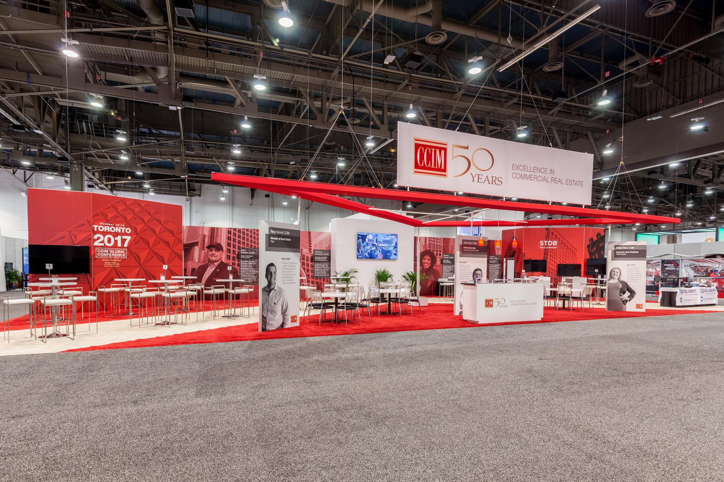
Notes:
Every year, this exhibit space is full of CCIMs meeting with clients, as well as young commercial real estate professionals who are considering earning the designation.

Slide 21
Volunteering and Governance
CCIM Institute is led by a group of dedicated CCIM volunteers. They hold leadership positions and serve on committees and advisory boards that help to define and direct CCIM's strategic goals.
CCIMs can shape the future of CCIM Institute and expand their professional networks by giving their time and expertise at the national or local chapter level.

Slide 22
Notes:
Consider attending one of our national meetings. They’re held twice a year – in the spring and the fall. Members like you can have a direct impact on the Institute’s strategic direction, and we welcome your input.

Slide 23
Technology Platform
STDB is commercial real estate’s advanced digital toolkit, providing essential data and tools to support financial, market, spatial, and competitive analysis. By integrating quality online data in a dynamic mapping environment, STDB helps professionals to serve their clients and win business.
All CCIM Institute Members can access:
ArcGIS Online
Business Analyst
Business List
Flood Maps
Express Center
CCIM designees also have access to oblique aerial images, financial analysis tools, promotional templates, and more.

Slide 25
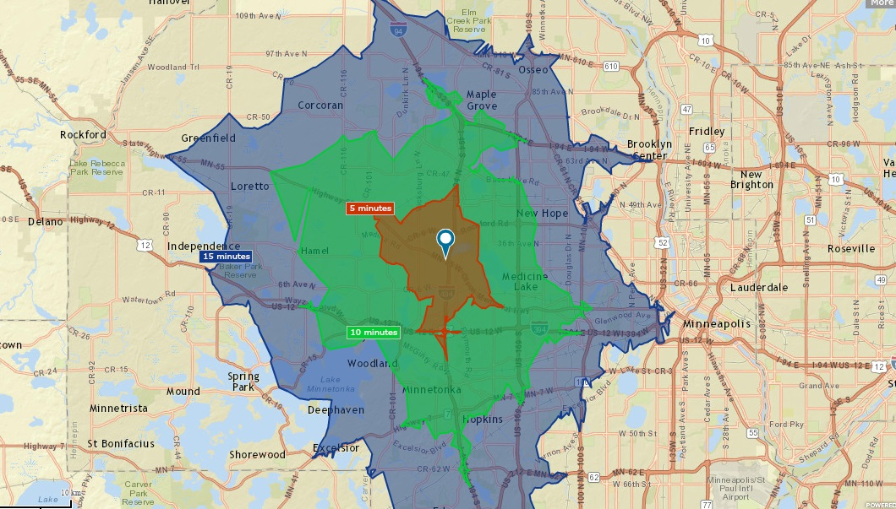

Slide 26
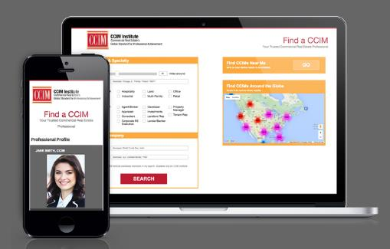
Technology Platform
CCIM.net Email with G Suite
Find a CCIM
DealShare
CCIM Connect
Excel Templates
Notes:
CCIM.net Email with G Suite
Showcase your designation by using a customized CCIM.net email account fully equipped with Google G Suite.
DealShare
Share exclusive property haves and wants directly with other CCIM members via DealShare, a preference-matching marketing platform.
CCIM Connect
A true online village, this is where CCIM Institute members share market intelligence, tell their stories, give opinions, and offer suggestions for improving everyday business life.
Find a CCIM
Your potential clients search the Find a CCIM database to identify qualified commercial real estate professionals in your market every day.
Excel Templates
Access pre-designed templates used in CCIM courses to deploy discounted cash flow analysis and other analytical models for commercial real estate.

Slide 27
Additional Benefits
Commercial Investment Real Estate Magazine Subscription The award-winning magazine of CCIM Institute covers market trends and innovations in every issue. The digital version is available to International members.
SelectLeaders CCIM Career Center Post résumés at no cost or find talent on this online job resource platform operated by SelectLeaders.
Commercial Real Estate Insights Series Members get priority access to CCIM Institute Chief Economist K.C. Conway’s reports on industry trends, including the future of site selection, adaptive reuse, and CRE finance disruption.

Slide 28
Affinity Provider Program
Your CCIM Institute membership gives you access to an operational platform that includes significant discounts on travel, printing, CRE technology, and more.
Commercial real estate marketing
Track deals and customer interaction
One-stop shop for commercial real estate sales and leasing
Commissions and accounting application for CRE
Commercial real estate marketplace and technology platform
Real estate mapping and property research application
Notes:
BigBoysBlast is a commercial real estate marketing tool that helps brokers and property owners market their commercial and investment property to over 10,500 investors and over 126,000 real estate professionals across the U.S., Canada, and internationally. CCIM members get $30 off the flier broadcasting service.
Biproxi includes a free commercial multiple listing service, marketing platforms for sales and leasing, and a suite of customized marketing tools - all geared toward improving the transaction process for middle-market CRE brokers, buyers, sellers and tenants. Biproxi helps brokers find more buyers and sell properties faster. CCIM Institute members receive a 10% discount on any products purchased through Biproxi's Marketplace, including professional property photos, aerial videos, and virtual staging.
ClientLook is commercial real estate CRM subscription, which gives you a platform to easily track deal activities, emails, clients, and more. CCIM members receive a 15% discount of the subscription.
CommissionTrac is a cloud-based application for all things commissions and accounting for commercial real estate. Members receive a 20% discount on the monthly retail price.
CREXi is a commercial real estate marketplace and technology platform dedicated to supporting every stakeholder within the CRE industry. CCIM members will receive a 30% discount on CREXi Broker Pro.
Digital Map Products’s LandVision™ is a cloud-based mapping application that helps real estate professionals find off-market opportunities and win more deals. CCIM members receive a 30% discount off retail pricing.

Slide 29
Affinity Provider Program
Mapping, aerials, flyers, and customer analysis for retail real estate
Printing and delivery services
Valuation, forecasting, and transaction platform
Demographic and site selection platform
Investment management software
Free CRE listing distribution platform in the world
On-demand printing for business and marketing materials
Engineering, environmental, and energy services
Notes:
Earthvision specializes in providing custom mapping, aerials, flyers, and customer analysis to the retail real estate industry. CCIM Members will receive 15% off services and 20% off flyers.
FedEx Office® Preferred Pricing Program offers CCIM members the following special rates: Black & white copies are 34¢ single-sided, color copies are 35¢ single-sided, and other production services are 15% off.
FUEL is a state-of-the-art cloud-based technology platform that is powering the next generation of valuation, forecasting, and transactions for CRE brokers, owners, lenders, and appraisers. CCIM Institute members receive a free 30 day trial and 33% discount off of the retail cost.
IdealSpot's demographic and site selection platform captures what people are actively searching for and interested in via search engines and social media and mixes it with traditional demographic data sets to tell you precisely where demand exists for your products and services. CCIM members receive 30% off all reports and subscriptions.
IMS (Investor Management Services) is the leader in the investment management software space providing the only all-in-one platform. CCIM members will receive an 15% off of their IMS subscription.
Leavitt Digital is the largest, free commercial real estate listing distribution platform in the world. CCIM Members may purchase Privileges Travel Savings Credits for 10 cents per dollar. Travel Savings Credits may be used at 350,000 hotels/resorts, major airlines, car rentals, cruises, safaris, and a number of exclusive brands.
MOO is a print-on-demand company specializing in premium business stationery and promotional materials. CCIM Institute members receive a 20% discount off of the retail cost. If Moo has a sale, CCIM members get the better sale price.
Partner Engineering and Science, Inc. provides market-leading engineering, environmental and energy services for the global commercial real estate industry. CCIM members who are new clients to Partner will receive a 10% discount.

Slide 30
Affinity Provider Program
Platform connecting commercial real estate professionals
Real estate marketing platform
Property listings, analysis, and CRM solutions
Integrated SEO, email, and social media marketing platform
Marketing platform for building owners, asset managers, and brokers
Travel discounts on hotels, rental cars, cruises, and more
Apps for business tools, calculators, and analysis reports
CRE coaching and consulting
Notes:
RealConnex is a platform connecting real estate professionals to capital, investments, services, and each other. CCIM Institute members receive access to a free six-month trial of the RealConnex Business Pro membership.
RealDash is an all-in-one software platform to prepare, launch, market, and close your deals. Use RealDash’s integrated tools and eliminate the need to work with multiple programs at once. CCIM members get 25% off the monthly plan and save 35% when purchasing an annual plan.
RealNex provides cloud-based real estate solutions in the areas of property listings, leasing/tenant representation, financial analysis, proposal/flyer/website creation, email marketing campaigns, and CRM for CRE professionals. CCIM designees receive free access to MarketEdge through Site to Do Business and all members receive 20% off any of their Annual RealNex Solution Subscriptions.
RealtyZapp.com is an integrated SEO, email, and social media marketing platform for real estate. CCIM Institute members receive a 35% discount on the first annual subscription, followed by a 30% discount on all subsequent subscriptions.
SharpLaunch is the premium marketing product in the industry for building owners, asset managers, and brokers who want to improve asset visibility, streamline marketing activities, and save time. CCIM members receive one month off any yearly SharpLaunch subscription and all setup fees waived.
Snazzy Traveler provides members with discount rates on hotels, rental cars, luxury cruises, and activities at discounts from 15% to 40%. CCIM members receive free access to Snazzy Traveler for an entire year, which normally costs $99.
TheAnalyst® PRO application provides over 20 powerful tools, accessible from your desktop and all mobile devices. CCIM Members receive free, unlimited access to seven of TheAnalyst PRO's most popular calculators and tools as well as a 20% discount on the full version’s annual subscription.
The Massimo Group offers transformative coaching for dedicated commercial real estate professionals who are looking to multiply their income and increase their free time. CCIM Institute members receive a 15% reduction of coaching fees off of retail prices.

Slide 31
Affinity Provider Program
REALTOR® Benefits Program
Members also receive access to the REALTOR® Benefits Program, which includes discounts on a wide array of services, as well as political advocacy and market reports.
Notes:
CCIM Institute is an affiliate association of NAR, which requires CCIM designees either be active REALTOR® members or an Institute Affiliate members of NAR. Both receive access to the REALTOR® Benefits Program, which includes discounts on:
tech gear from Dell, Lenovo, Sprint, and Xerox
car rentals from Budget, Avis, and Hertz
marketing resources like FedEx
insurance options for health, dental, and vision
transaction management applications like DocuSign and zipLogix

Slide 32
Preparing for Tomorrow
Cultural Diversity Education Program
CCIM Institute created this program in 2002 to foster a critical mass of qualified minority CCIM designees who can positively impact their communities.
CCIM Veterans in Real Estate Program
Through the G.I. Bill, U.S. veterans and beneficiaries can now receive a full scholarship to earn the CCIM designation.
University Outreach, CCIM Mentor, and Other Programs for Young Professionals
CCIM Institute has partnered with more than 50 universities and other industry associations to raise awareness about careers in commercial real estate.

Slide 33
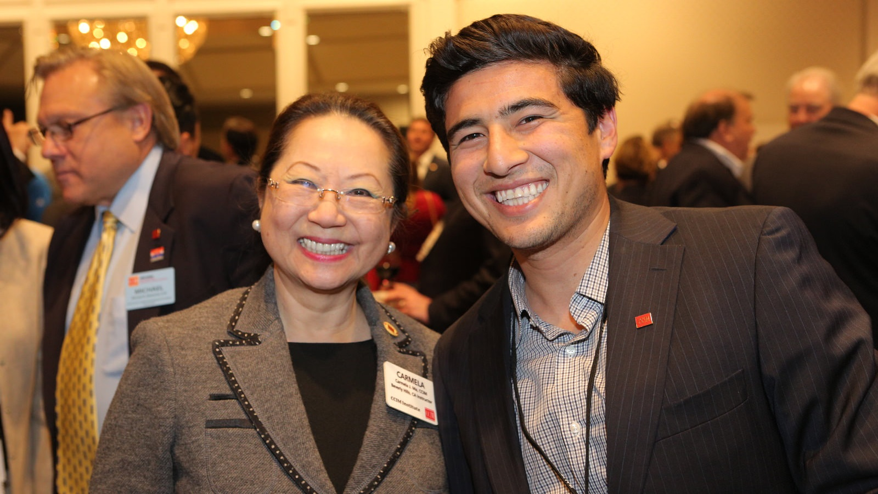
Notes:
CCIMs have a key role to play in preparing the commercial real estate industry for tomorrow. Whether its using your membership benefits to help a client succeed, training your team with CCIM courses, or simply wearing your red lapel pin to your next meeting, you can be a positive force. We’re proud of the CCIM legacy, and we’re thrilled that you’re part of it.

Slide 34
Experience life with the pin.
Visit www.ccim.com/benefits

