Slide 1
Portfolio of Qualifying Experience
Understanding the Submission Process.

Slide 2
Who are you? – What do you do?
Commercial Real Estate Broker/Agent/Investor
Commercial Leasing
Residential Investment
Mortgage/Finance
Asset/Portfolio Manager
Managing Brokers/Owners
Consultants/Exchange Facilitators
Developer
Corporate Executives
Identify your specific profession and follow the guidelines in the portfolio handbook

Slide 3
Requirements for earning the CCIM designation:
Become a Candidate of the CCIM Institute.
Complete all four Core Classes (must take at least one instructor-led course)
Complete 8 hours of Negotiation Training (online or classroom)
Must be completed prior to taking CI 103 or CI 104.
Complete two Electives (will receive 0.5 elective credit for completion of Negotiation Training)
Complete free online CCIM Ethics training
The submission and approval of a Portfolio of Qualifying Experience
Successfully Pass the Comprehensive Exam

Slide 4
Misuse of the Designation, Logo, and Candidacy Status
Institute Candidates, members who are pursuing the CCIM designation, may NOT display the CCIM designation or logo in any manner and may ONLY refer to their candidate status “ in a resume to a prospective employer or broker”.

Slide 5
When should you submit your portfolio?
Portfolios may be submitted at any point during candidacy following completion of CI-101.
The published portfolio deadline is the last date for which portfolios will be accepted to allow sufficient time prior to the Comprehensive Examination for review and grading.
You are strongly encouraged to start compiling your portfolio file once you complete CI-101.

Slide 6
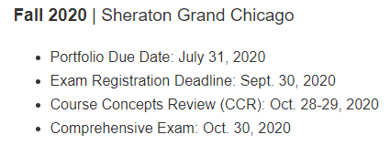
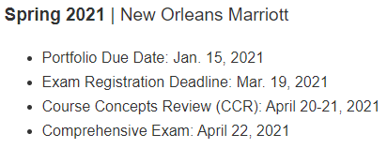
Candidate Guidance Schedule
Recommendation letters are to be requested 2 weeks prior to the portfolio submission deadline.

Slide 7
Volume Requirements
All transactions must have been completed in the past five (5) years.
3 or more qualifying activities totaling $30 million or more; OR
Exactly 10 qualifying activities that total $10 million or more; OR
20 qualifying activities without regard to total volume

Slide 8
What are Qualifying Activities?
Qualifying Activities are defined as:
Completed/Closed Commercial Real Estate activities in which you materially participated within FIVE years of the Portfolio Submittal Date.

Slide 9
Qualifying Activities
Sale/Purchase/Exchange
Must involve a Deed
Value based on closing price
Commercial Investment Real Estate Lease
1 year or longer
Value equal to the total “Base Rent” due
Residential Leases do not qualify
Renewals usually do not qualify

Slide 10
Qualifying Activities
Commercial Real Estate Development
Must be completed
Value based on sale of property or 3rd party appraisal
Commercial Mortgage Financing of Commercial Real Estate
Must be a Lender or Mortgage Broker
First-position loans only
Loans acquired for you/your company do not qualify

Slide 11
Qualifying Activities
Qualifying Activities
Commercial Real Estate Consulting
Must be third-party consulting agreement
Full copy of the consulting report and proof of payment
Commercial Appraisals by commercial Appraisers

Slide 12
Qualifying Activities
Active Managers of Commercial Investment Real Estate Representatives/Agents
Commercial Investment Real Estate Active Advisor
($500,000 in fees)
Non-Transactional Professionals - Asset Managers/Corporate RE Exec, etc. (large commercial organizations)

Slide 13
Non-Qualifying Activities
Apartment Management and Apartment/Residential Leasing
Assumption Loans
Construction/Building, Space Planning, Remodeling, Project Management of commercial or investment real estate
Sale of Businesses
Land: sales of less than four single-family unimproved lots i.e. residential land
Leasing of self storage units, boat slips, billboards
Mortgage financing on residential property of four or less units.
Property Management Duties
Referral fees from any source including commercial real estate
Secondary or underlying loans of commercial real estate
The sale or purchase or exchange of personal residences
Auctioning of Real Estate - may qualify if certain functions were performed (see Exchange/Sales/Acquisition)
Academic analysis/consulting/coursework
Real Estate Notes
Flipping houses
Broker Opinion of value
Residential appraisals
Land sales of four (4) or less single-family unimproved lots
Investment Activities (REITS, Stock Funds, Limited Partnerships, etc.)
All residential investments leases, including apartment lease condominiums and student housing
Other activities not listed here may not qualify. If you have a question on Qualification, please review the Portfolio Handbook.

Slide 14
Questions About Qualifications
Where there is a question of whether your specialization qualifies for the designation, refer it to the overall principal:
There must be substantial involvement with real property of a commercial and/or investment nature.
The Portfolio Handbook is your main resource for compiling your Portfolio of Qualifying Experience.

Slide 15
Three Submission Options Streamlined, Streamlined Non-Transactional, Traditional
1. Streamlined (Online)
The Streamlined Portfolio is only available for Commercial Real Estate Professionals with five (5) or more consecutive years in the Commercial real estate industry.
Required Contents:
Streamline Application
Professional Resume of work experience (employment history) confirming at least five (5) years in the commercial real estate industry.
Summary of your Qualifying Activities
Signed and notarized affidavit from a Managing Broker, Supervisor, CPA, etc.
Detailed explanation of Role and Responsibilities
Three letters of recommendation:
CCIM Designee (who does not work in the same firm or is related to you)
Client (someone whom you have worked for in a professional capacity)
Local Chapter Representative (an authorized representative)

Slide 16
Three Submission Options (Continued)
2. Streamlined Non-Transactional (Online)
This category consists of those high-level full-time commercial professionals whose primary function is a substantial contribution to commercial property that does not include brokering actual transactions; thus no volume is applicable. Five or more consecutive years in the same role/leadership responsibility is required to submit under this category. This category includes:
Bank and Trust Real Estate Asset Managers/Institutional Portfolio Managers
Large and Institutional Corporate Real Estate Department (Leaders/Officers/Managers/CPA firms)
Managing Brokerage Officers/Managers of large firms (supervising 20+ fulltime commercial agents)
Large Public Private Venture Program Directors/Managers/Specialists
Required Contents:
Streamlined Non-Transactional Application
Professional Resume of real estate experience (employment history)
Signed and notarized Affidavit which includes verification of at least five years in the same role
Detailed explanation of Role and Responsibilities in your position
Company Organizational Chart
Three letters of recommendation:
CCIM Designee (who does not work in the same firm and not related to you)
Client (someone whom you have worked for in a professional capacity)
Local Chapter Representative (an authorized representative)

Slide 17
Three Submission Options
3. Traditional (Online)
The Traditional Portfolio is for Commercial Real Estate Professionals with a minimum of 2 consecutive years of full-time experience in the commercial real estate industry.
Required Contents:
Traditional Application
Resume
Summary of Qualifying Activities
Activity Data Form for each Activity
Detailed explanation of Role and Responsibilities
Copies of Closing or Settlement for each activity
Verification of employment on company letter head indicating candidate's full name, role with company, start/end dates, and name and position of signer. Letter must be notarized.
Two proofs of material participation in each activity. In addition to Settlement documents Examples include:
Commission checks
Signature on settlement or closing documents
Copy of deed showing candidate as grantee or grantor
Signed listing agreement with candidates name
Notarized statement from client or supervisor
Recommendation from the local Chapter Representative
Note: Commercial Lease Renewals or Residential Investment Income Properties MUST use the Traditional option.

Slide 18
Explanation of Required Contents
• Application: All portfolio submissions must include an application. Each field on the form should be completed, and the application must include your signature.
Professional Resume: A professional resume of employment history dating back far enough or confirming at least five (5) years in the commercial real estate industry is required. This document can be submitted in any format as long as there is enough detail to verify the experience.
Roles and Responsibilities: This document should provide a summary of all functions performed within your current position. It differs from the resume, which typically provides an outline of your career. Portfolio Reviewers rely on this document to clarify who you are and what you do as a real estate professional. This document can be submitted in any format.
Affidavit: An affidavit must be submitted for each company that you have worked for in the past five years. If you are the owner of the company, an employed CPA must verify ownership of business and the potential volume in commercial activities. Affidavits are not required under the traditional track.
Proof of Material Participation: includes two of the following
Your signature on the closing statement, contract or lease declaring you as principal, witness, agent, president, listing agent, selling agent, buyer/seller or lessee/lessor.
A copy of the check that shows the commission paid to you for your role (must indicate the property’s address, especially in the case of a lease).
A copy of the deed showing you as grantee or grantor.
A signed listing agreement with your name on it.
Notarized statement from client or supervisor – only 1 per transaction, must be on company letterhead and include a detailed explanation of your role.
If you are paid a salary provide your contract, job description or other verification.
Letters, emails from Clients & Cooperating Brokers demonstrating your involvement in the transaction.

Slide 19
Required Contents (Continued)
Recommendations: The letters of recommendation are essential components of the portfolio submission because they provide specific information related to a candidate’s personal and professional characteristics or accomplishments. Up to three recommendations may be required.
CCIM Recommendation: CCIM’s providing recommendations must be active members of the Institute. If you do not already know a CCIM designee, ask your chapter representative if he/she is willing to collaborate with another CCIM (a local chapter member) to conduct a panel interview as a means of obtaining both recommendations. CCIM recommendations are only required for streamlined submissions.
Client Recommendation: If you are not working with a client: Provide a recommendation from someone outside the company, such as an attorney, certified public accountant, title officer, or other professional who you conduct business with who can vouch for your knowledge of the real estate business and your professionalism. Client recommendations are only required for streamlined submissions.
Chapter Recommendation: The appointed chapter representative must complete the chapter recommendation letter. To request chapter recommendation, candidates must notify the local chapter and schedule an in-person or phone interview with the appointed chapter representative. Candidates must be prepared to send the verification and recommendation form, a professional resume, and a summary of qualifying activities to the chapter representative prior to the interview.
Candidates should plan to discuss their past work history in commercial real estate at the interview. It may also be helpful for candidates to familiarize themselves with their local CCIM chapter’s benefits and services.
Requests for recommendations must be submitted at least two weeks before the published portfolio deadline.

Slide 20
Not sure which option is best for your type of Activities?
QUICK TIPS:
If you plan to submit Commercial Lease Renewals, Financial Analysis or Residential Investment Income Properties MUST use the Traditional option.
Residential Income properties of 5 or more units automatically qualifies as commercial real estate and can be submitted as a Streamline portfolio
If your role is listed below and has been for the past 5 years you may qualify as a Non-Transactional Professional and should use the Streamlined Non-Transactional Option.
Bank and Trust Real Estate Asset Managers/Portfolio Managers
Large and Institutional Corporate Real Estate Department (Leaders/Officer/Manger/CPA Firms)
Managing Brokerage Officers/Managers of large firms (supervising 20+ full time commercial real estate agents)
Large Public Private Venture Program Directors/Managers/Specialists
If you don’t feel that you qualify under any of the listed Qualifying Activities forward your professional resume and/or roles & responsibilities to Designation@ccim.com for advance review.

Slide 21
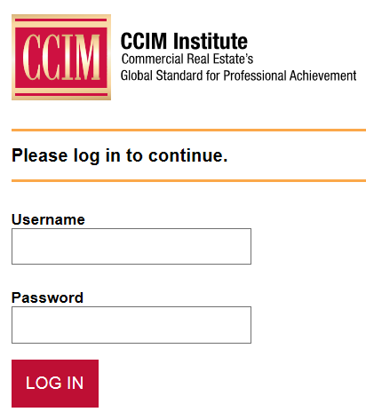
Getting Started- Online Submission
You can access your Online Portfolio account by going directly to http://portfolio.ccim.com to login.
Experiencing issues? Contact the Designation Department at 312-321-4517

Slide 22
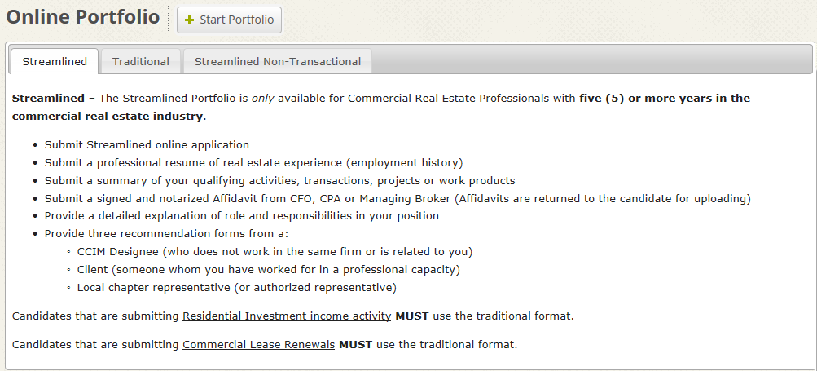
Begin Portfolio
Click “Start Portfolio” to begin your submission. You will have the opportunity to save your work and login later to continue.

Slide 23
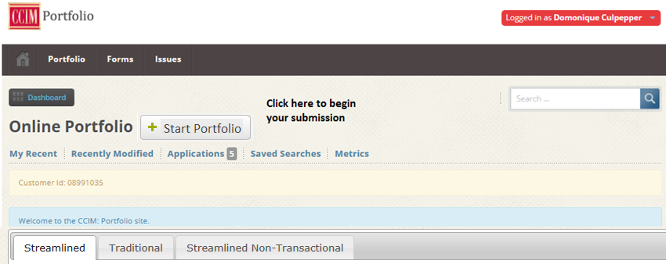
Creating a portfolio workspace
If you are returning to your workspace to add documents, the Start Portfolio button will change to

Slide 24
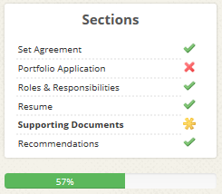
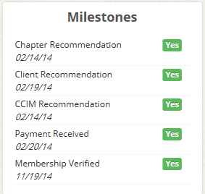
Helpful Tools
These tools will appear throughout the upload process.
Shows what documents you have uploaded, have not uploaded and are currently working on. Each title will take you to that document location.
Shows receipt of membership payment, submission fee payment and recommendations
Shows your progress of completion
Navigation tools

Slide 25
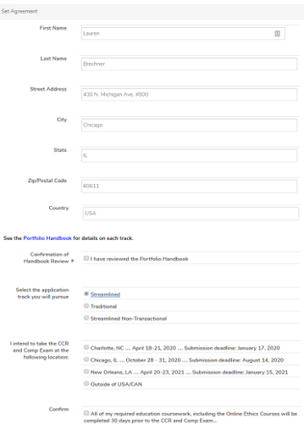
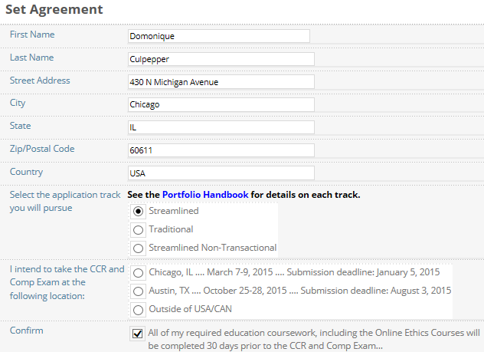
Submit Agreement
Enter any updated contact information
Confirmation of Handbook Review
Select your submission track
Where will you take the exam?
Acknowledge requirements will be met

Slide 26
Uploading Documents
Examples of the uploading portfolio documents
Here a form is provided. Download the form to complete and save to your computer before uploading
Here, simply type in the space provided
Upload in any format; No form is provided
Mark each section complete as you go

Slide 27
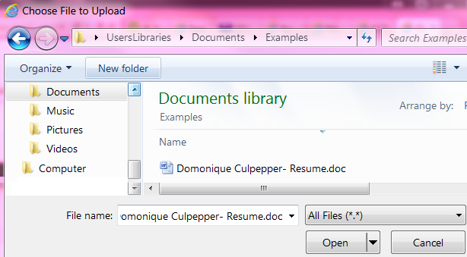
To upload a document…
Click Choose File
Double click the document you want to upload
Your uploaded document shows here.
If you need to delete your upload simply click the X

Slide 28
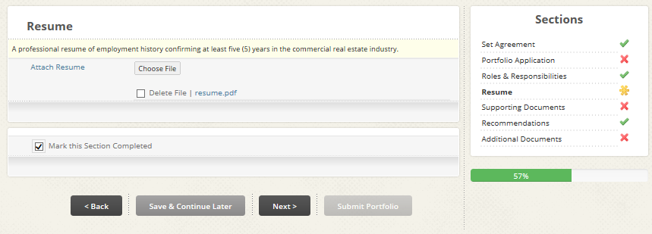
Confirm document
Easily View or Delete documents.
Once you have uploaded all documents and have submitted your portfolio you will not be able to make changes.

Slide 29
Payment
Once you have submitted your portfolio the below screen will appear. Portfolios will not be reviewed without submission fee payment and active membership.

Slide 30
Results
Results will be emailed within one week of the review session. If you do not receive your notice within one week of the review session, check your Junk folder or login to the portfolio portal to see your status.
Once your portfolio has been reviewed you will receive an email notifying you that your portfolio is either Approved, Disapproved or Incomplete.
Approved- Your portfolio is approved; you have completed this requirement of the designation process
Incomplete- Your portfolio has not yet been approved. You are missing minor items (i.e. signature, date, recommendation). Once you supply the missing item(s) to the Designation department your portfolio will be approved and you will receive an emailed approval notice.
Disapproved- Your portfolio does not meet the required standards. You will have 30 days to provide the requested information directly to your specified reviewer to attempt to overturn the disapproval. You and your reviewer will communicate directly.

Slide 31
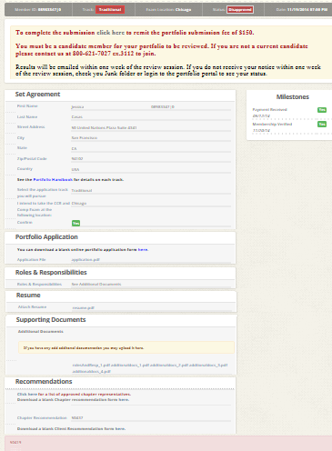
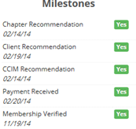
You may login to your portfolio workspace at anytime to update yourself on pertinent details regarding your submission.
Here you see the status of your portfolio
Milestones will reflect our receipt of submission fee, verification of membership, and recommendation letter(s).
Once you submit and your portfolio has been reviewed, the reason for any disapproved or incomplete status will show at the bottom of the screen. You will also receive an email notification.

Slide 32
Portfolio Submittal
Timeline: Published portfolio deadlines refer to the last date that will allow for review and grading prior to the next Comprehensive Examination. Portfolio Review sessions are scheduled in advance of the Comprehensive Examinations to allow sufficient time for revisions and re-grading. Portfolios may be submitted at any time during your candidacy and after CI 101 is completed. Those who have completed all their education requirements and whose portfolios have been approved by the Comprehensive Examination deadline will be eligible for that exam.
Portfolio Grading: While one portfolio reviewer is assigned primary responsibility for your portfolio, it is reviewed within a team of experienced CCIM designees to ensure objectivity and consistency. Grading results are reached by unanimous decision, and all disapproved portfolios are personally reviewed by the Designation Committee vice-chair for portfolio grading before the decision is finalized.
Grading Results: Results of the grading session are e-mailed within one week of the grading session. Candidates are asked to refrain from calling for results unless they have not received them by e-mail within one week of the grading session.
Portfolio Revisions: Revisions of disapproved portfolios will be accepted for re-grading until 30 days from notification. If revisions are approved and all other requirements are fulfilled, the candidate may submit the application for CCIM Designation and register for the Comprehensive Examination. The Institute will only hold disapproved portfolios for one year.

Slide 33
Portfolio Submittal
Disqualifications: Breach of these rules may result in disqualification of individual activities or the portfolio in its entirety. Duplicate portfolios/activities in the case of partnerships or teams will result in the disqualification of all related portfolios. Falsification of information will permanently disallow the entire portfolio.
Appeals Process: Applicants whose Portfolios of Qualifying Experience are disallowed may appeal that decision to a review board comprised of three members selected from each of the following committees: Executive Designation, and Professional Standards. Members are appointed by the CCIM President.
International Portfolios: A person who is not a U.S. or Canadian resident and is considered to be a foreign national resident must submit an International Portfolio in the Traditional format. All portfolios must be submitted in English. Supporting documentation that is submitted in a foreign language must highlight and translate the type of document, name of candidate, transaction amount and names of parties involved into English and the U.S. dollars on the document. International candidates are not eligible to submit a streamlined portfolio.
Confidentiality: Contents of the portfolio are kept confidential by the Institute. To guarantee the confidentiality of sensitive information and avoid conflicts of interest, graders do not review portfolios submitted from their own state or from candidates with whom they are familiar.

